Slide 1
Building the Future Community Forum December 14, 2021

Slide 3
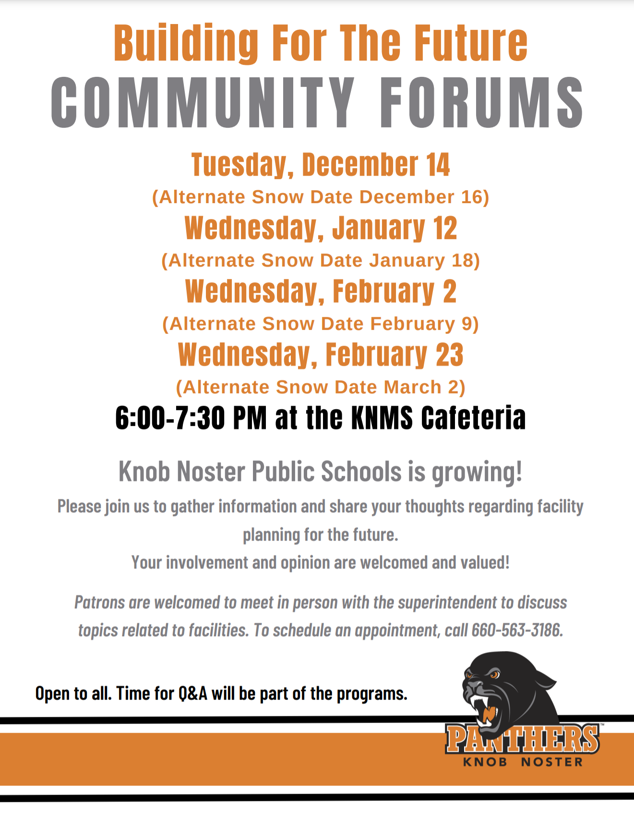
Discussion Topics
1. Current State of Performance in Knob Noster Public Schools
2. Public K-12 Education: The Number One Issue Impacting Military Mission Readiness & Quality of Life
3. The Role of Knob Noster Public School in Driving Community/Economic Development
4. Why the Need for a New Knob Noster High School
5. Current State of Affairs in Knob Noster Public Schools
6. Overview of Local Tax Effort and Federal Impact Aid
7. Overview of the Defense Communities Infrastructure Program and Infrastructure Bill
8. Current Progress towards the Plan
9. Preparation for Open Enrollment
10. Next Steps

Slide 4
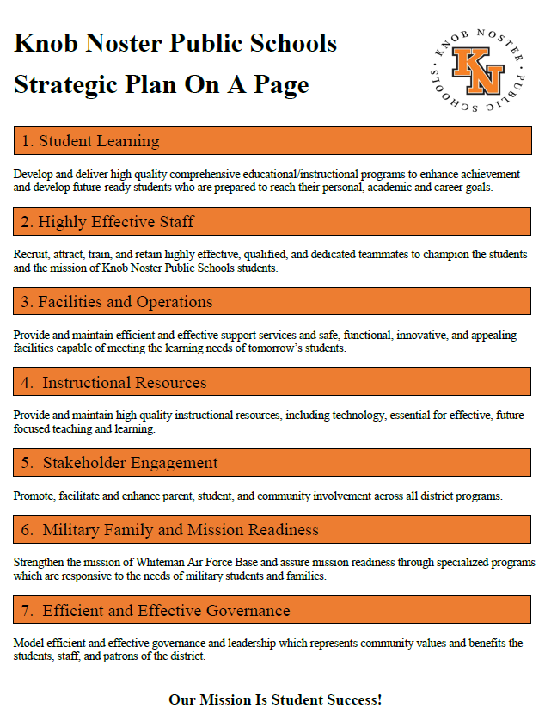

Slide 5
1. Current State of Performance in Knob Noster Public Schools
2021, 2020, 2019: Knob Noster High School was recognized as Missouri’s # 1 Rural High School for college and career readiness by US News and World Report.
2021, 2019 & 2017: Knob Noster Public Schools received the prestigious General Pete Taylor National Partnership of Excellence Award for its strong partnership with Whiteman Air Force Base and affiliate organizations.
2021, 2019: Knob Noster Public Schools was profiled by Air University as an exemplary example for partnership between for its exemplary military child education programs and partnership with Whiteman Air Force Base.
2018: Forbes Magazine profiled Knob Noster Public Schools as a model for military-student education and academic improvement.

Slide 6
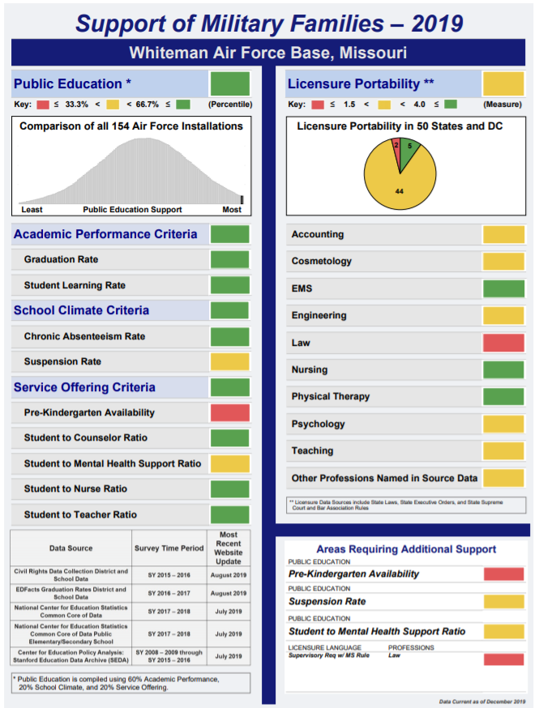
Air Force Study on
Quality of Education
Ranks
Whiteman / Knob Noster
# 1 in the U.S.
(out of all 157 Installations)

Slide 7
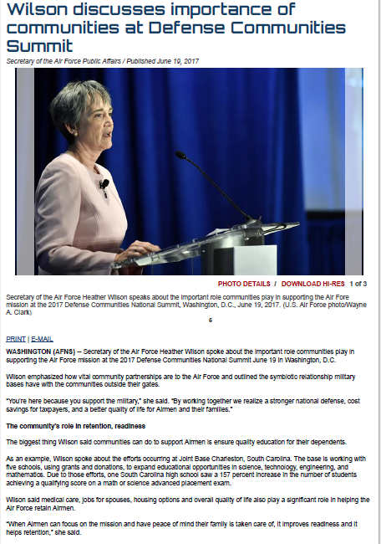
Public Education is A Quality of Life Issue for Military Families “The biggest thing communities can do to support Airmen is to ensure quality education for their dependents.” Former Secretary of the Air Force Heather Wilson
2. Public Education: The Number 1 Issues Impacting Readiness

Slide 8
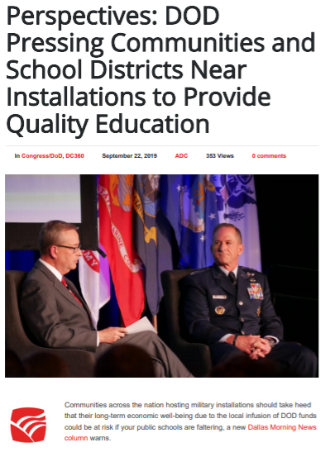
Quality of Public Education
May Impact Future Basing Decisions
“As I visit installations, the No. 1 quality of life issue of airmen with children is access to good schools,” he told attendees. “They’ll say, ‘Hey, chief, you can deploy me, you can send me to tough locations, you can make me live in small rural communities … we’re in. But once you start affecting the quality of our children’s education, that’s when we’re going to make difficult decisions.'”
“As we make future basing decisions … we’re going to start at some of those quality of life issues because of retention. Airmen are not going to stay in the United States Air Force if I’m moving them between school systems that are all over the map.”
Former Chief of Staff of the Air Force General Dave Goldfein

Slide 9
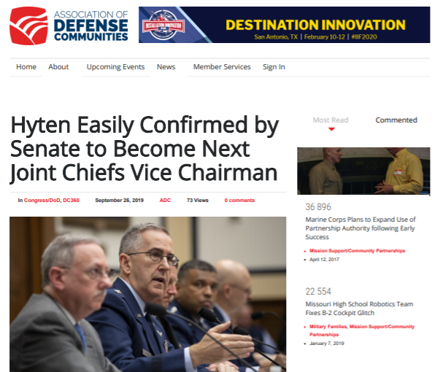
Knob Noster Public Schools understands that strong schools make installations stronger.
Our recent partnership with Whiteman AFB serves as a good example of a good example.
This DCIP – P4 proposal represents a replicable model for a K-12 infrastructure partnership.

Slide 10
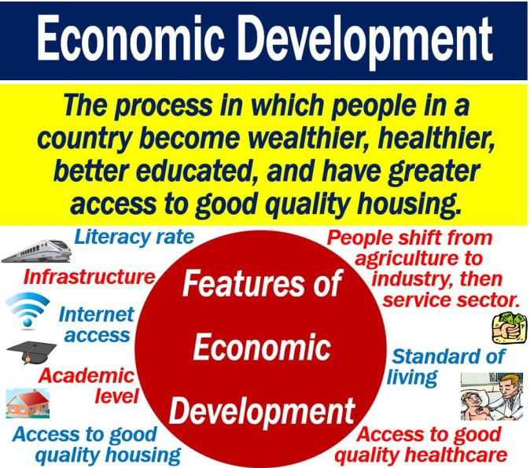
3. The Role of KNPS in Driving Community / Economic Development
KNPS is largest employer in the community other than WAFB.
Residential development
Business development
Increase in assessed valuation over time due to growth
Increase in property values
Increase in community amenities

Slide 11
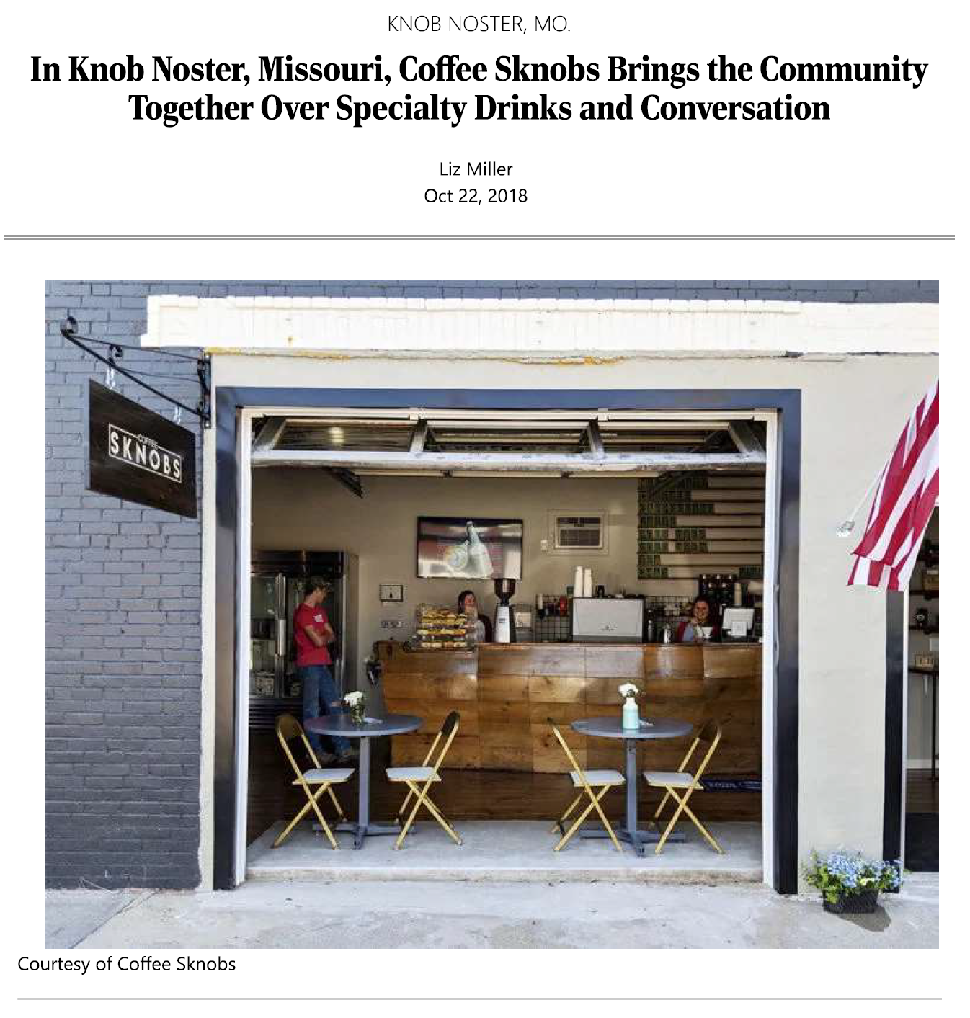
Missouri Main Street was brought to Knob Noster in 2016 through support of KNPS and Knob Noster BOE Members.

Slide 12
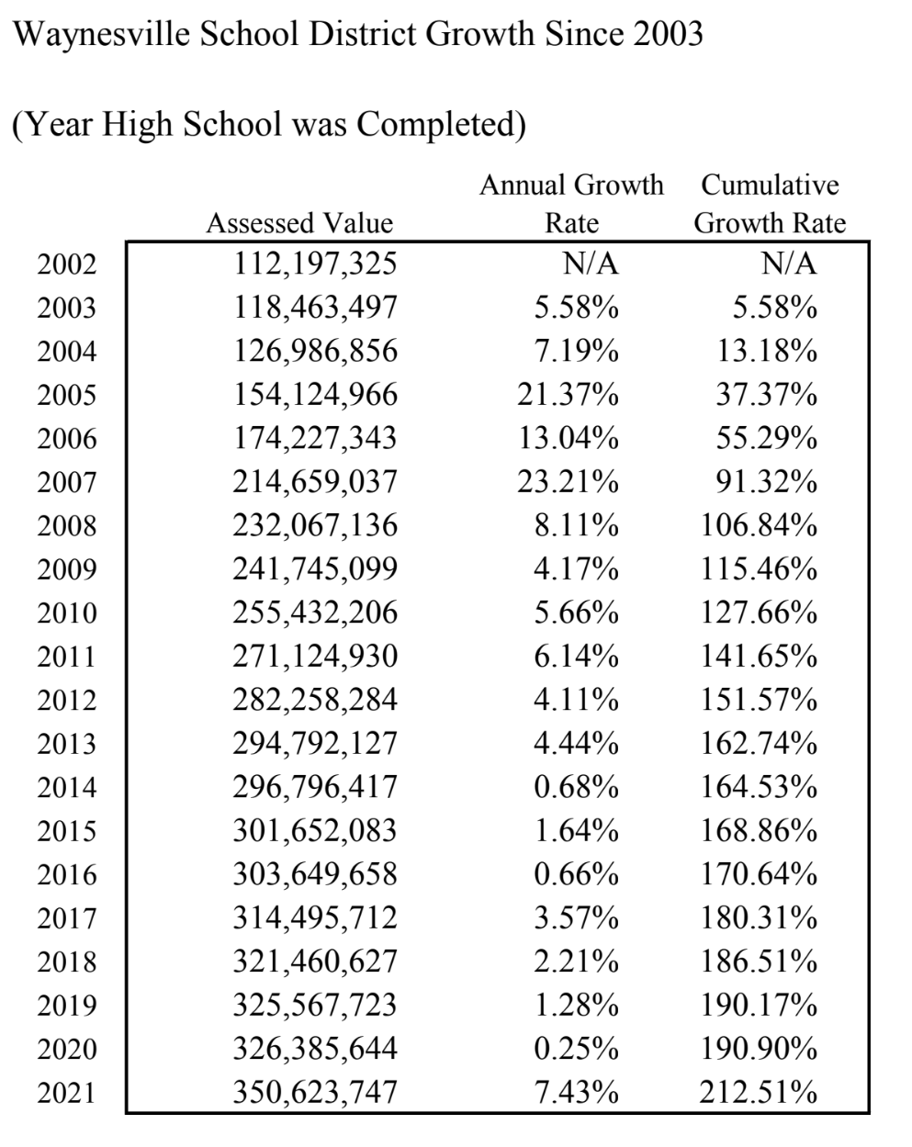
3. Example of Economic Growth Following School Construction Project

Slide 13
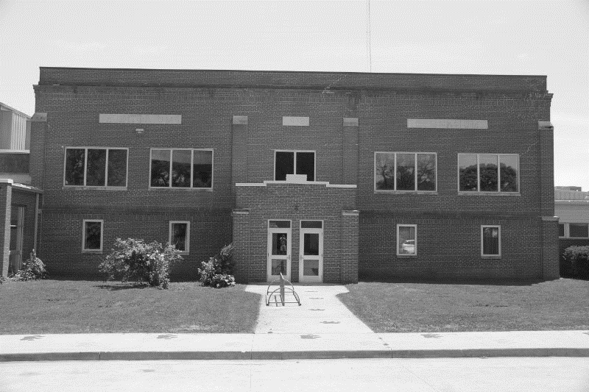
4. Why the Need for a New Knob Noster High School
2013 Input from Community Stakeholders (PreK & PAC
2016 Facility Assessment
Growth in Student Enrollment (15%) – Buildings are at or near Capacity
Expansion of Preschool Offerings (Funding available)
Support for Middle School Facility Needs (activities and athletic facilities) (space conflicts)
Support for High School Facility Needs (Career Education Space, Flexible Use Space, Gym Space, Athletic Field Replacement / Redundancy, Performing Arts Center
Youth Sports
Community Storm Shelter

Slide 14
4. Components of the Proposed High School Innovation Campus
1. New Knob Noster High School Innovation Campus:
A. Robust K-12 Certificated Career Pathways in STEM, Robotics, Cybersecurity, and Aviation (B-21 & F35)
B. Transitioning Veteran Job Placement as Specialty Educators in the Above Pathways, and Others
C. Certificated Career Pathways for Students and eventually for Transitioning Veterans (Adult Learning) in the Above Fields of Study Creating a Unique STEM Ecosystem
D. Robust Advanced Placement / Dual Credit Courses and Unlimited Virtual Learning Options for All Learners, Creating An Early College High School
E. Expanded Preschool / Childcare Services for Families
2. Multiple All-Weather Indoor and Outdoor Joint-Use Youth and Adult Athletic and Activities Facilities
3. Integrated FEMA P-361 Safe Room and Storm Shelter Available to the Knob Noster and Whiteman AFB Communities
4. Integrated Whiteman/Air Force History Museum and Performing Arts Center Operated by KNPS Students (Alternate Component Based on Grant Funding)
*Add on project planning will follow with Private Partners for off-base Housing Developments

Slide 15
5. Current State of Affairs in KNPS
Staff: 250, Advanced Degrees, Destination of Choice
In House Operations: Food Service, Transportation, Maintenance
Finances: $9.7 to $22.6 since 2015, Bus Fleet, Programs, 1:1, Facility Projects
Student Academic: # 1 on AF Study, 3 years running # 1 by US News, multiple state and national awards, Little Wingmen Preschool
Student Extracurriculars: Soccer, Cross Country, Shooting Club, Robotics, JROTC Raiders, Cyber Patriot
Grantmaking: $10 million since 2016
Military Family Advocacy: National Spotlight
Stable Governance: Board and Administration stabilized since 2015
Return on Investment: Highest Performance, Lowest Taxes

Slide 16
Current Academic Program Partnerships and Initiatives

Slide 17
Knob Noster Public Schools’ Capacity for Achieving Excellence
2019: Knob Noster High School was recognized as Missouri’s #1 Small and # 1 Rural High School based on academic performance, college and career readiness, and comprehensive academic success.
2019 & 2017: Knob Noster Public Schools received the prestigious General Pete Taylor National Partnership of Excellence Award for its strong partnership with Whiteman Air Force Base and affiliate organizations.
2019: Knob Noster Public Schools was profiled at the Air University Education Symposium for its exemplary military child education programs and partnership with Whiteman Air Force Base.
2018: Forbes Magazine profiled Knob Noster Public Schools as a model for military-student education and academic improvement.

Slide 18
6. Overview of Local Taxes and Impact Aid
70% Military-student affiliation
Impact Aid
2013 Voter Initiative
Utilities Pipeline – Hancock Amendment
Local Effort
Phase 1 – No Tax Initiative
Phase 2 – Grants First

Slide 19
Impact Aid Revenue and Local Revenue Comparison
Year | Total Impact Aid Revenue | Total Local Tax Revenue
2021 | $7,183,103 | $2,360,657
2020 | $6,364,204 | $2,137,184
2019 | $8,896,694* | $2,053,956
2018 | $5,307,981 | $1,965,990
2017 | $3,289,883 | $1,964,121
2016 | $4,775,341 | $2,033,971
* Late payment received from 2017

Slide 20
2021 Tax Rates for School Districts Across the Region and Across the Missouri River Valley Conference
District | Tax Rate | Rank | District | Tax Rate | Rank | District | Tax Rate | Rank
Chilhowee | $5.51 | 1 | Leeton | $4.81 | 13 | Calhoun | $4.01 | 25
Harrisonville | $5.48 | 2 | Lafayette Co | $4.81 | 14 | Sedalia | $4.01 | 26
Excelsior Springs | $5.28 | 3 | Johnson Co R-VII | $4.75 | 15 | Green Ridge | $3.93 | 27
Warrensburg | $5.27 | 4 | Odessa | $4.71 | 16 | La Monte | $3.84 | 28
Montrose | $5.24 | 5 | Holden | $4.59 | 17 | Smithton | $3.65 | 29
Lexington | $5.21 | 6 | Davis | $4.56 | 18 | Henry Co R-I | $3.56 | 30
Oak Grove | $5.14 | 7 | Richmond | $4.54 | 19 | Warsaw | $3.55 | 31
Grain Valley | $5.11 | 8 | Concordia | $4.52 | 20 | Knob Noster | $3.48 | 32
Santa Fe | $4.98 | 9 | Shawnee | $4.50 | 21 | Leesville | $3.37 | 33
Carrollton | $4.93 | 10 | Pleasant Hill | $4.49 | 22 | Pettis Co R-XII | $2.79 | 34
Clinton | $4.91 | 11 | Wellington Nap. | $4.47 | 23
Kingsville | $4.82 | 12 | Pettis Co R-V | $4.04 | 24

Slide 21
Four County & Conference Cohort | Board Identified Cohort | Each cent of additional tax levy will produce $7,172 annually. Moving to the same rate as Warrensburg taxpayers would produce $1.3 million in additional revenues annually.
Mean Average $4.50 | Mean Average $4.72
Median Average $4.81 | Median Average $4.81
Knob Noster $3.48 | Knob Noster $3.48
Moving to Median would produce $950,000 in additional revenues annually. | Moving to Median would produce $950,000 in additional revenues annually.
Considerations for a Potential Voter Ballot Tax Measure
(for information and awareness only)

Slide 22
7. Overview of Defense Communities Infrastructure Program and Infrastructure Bill
DCIP
Association of Defense Communities
Infrastructure Bill
Endorsements

Slide 24
7. DCIP Proposal for KNHS Innovation Campus Endorsements
Knob Noster Board of Education
Governor Mike Parson
Senator Roy Blunt
Senator Josh Hawley
Congresswoman Vicky Hartzler
Former 509 BWC Col Jeff Schriener
Former 509 BWC Brig Gen John Nichols
Former 509 BWC Brig Gen Paul Tibbets

Slide 25
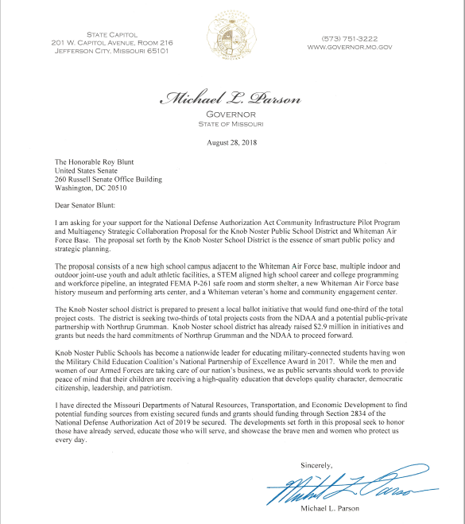
Commitment of Support from Missouri Governor Parson
“I have directed the Missouri Departments of Natural Resources, Transportation, and Economic Development to find potential funding sources from existing and secured funds and grants, should funding through Section 2834 of the National Defense Authorization Act of 2019 be secured.”
Missouri Governor Mike Parson
August 28, 2018

Slide 26
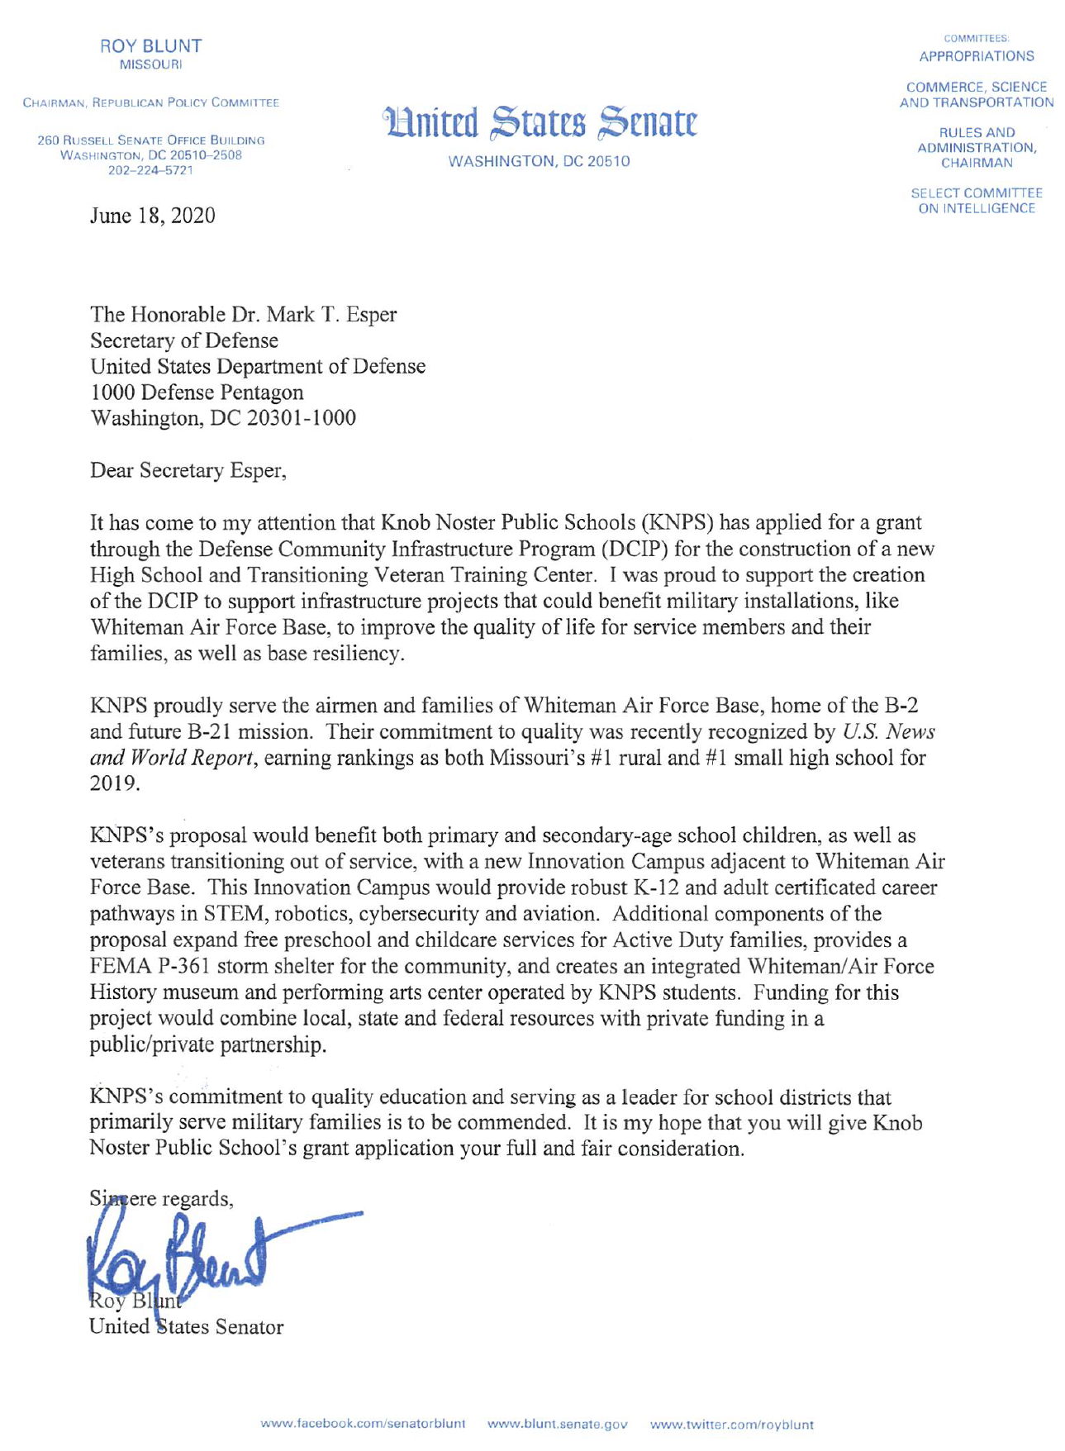
Commitment of Support from Missouri Senator Blunt
“This innovation campus would provide robust K-12 and adult certificated career pathways in STEM, robotics, cybersecurity and aviation. …free preschool for active duty families….storm shelter for the community….history museum and performing arts center.”
Senator Roy Blunt
June 18, 2020

Slide 27
7. Current Progress Toward the Plan
No Action – Implications
Reserve Balances
Acquisition of New Site
SEMA Grant: $4.5 million Grant
Little Wingmen Preschool: $1.0 million DODEA Grant
STEM Grants - $4 million and counting

Slide 28
Knob Noster High School
Innovation Campus & Transitioning Veteran Training Center
Project Value Proposition
WHITEMAN AFB
1. New Knob Noster High School Innovation Campus and Transitioning Veteran Learning Center
Strengthen mission readiness and enhance quality of life at Whiteman AFB through a new Knob Noster High School Innovation Campus and Transiting Veteran Learning Center, enhanced joint-use facilities, specialized military-family services, targeted workforce development, innovative, academic programs.
2. Multiple All-Weather Indoor and Outdoor Joint-Use Youth and Adult Athletic and Activities Facilities
Enhance Whiteman Air Force Base amenities, while significantly reducing overall cost of ownership of recreational properties through joint-use partnerships.
GROUNDBREAKING SET FOR SUMMER 2022 – PHASE I OF CONSTRUCTION PROJECT
3. STEM Aligned High School Student and Veteran Career and College Programming and Workforce Ecosystem
Strategically align academic programming to supply graduates equipped to immediately enter college or careers in STEM, Robotics, Cybersecurity, Computer Science, Aviation, or the Armed Services.
4. Integrated SEMA P-361 Safe Room and Storm Shelter to Serve the Whiteman AFB and Knob Noster Communities
Enhance safety for students, residents, employees and visitors of Whiteman AFB, through delivery of a SEMA P-361 Safe Room and Storm Shelter that will remain immediately accessible 24 hours a day 365 days a year. SUBSTANTIALLY AWARDED OCTOBER 2021
5. Whiteman Air Force Base History Museum and Integrated Performing Arts Center
Achieve historical preservation and engagement of the Air Force with our nation’s citizenship through establishment of the Whiteman Air Force Base History Museum and Whiteman Performing Arts Center.
6. Enhanced Early Childhood Learning Center
This Facility Expansion will create space in existing facilities to allow for the expansion of Childcare Programs to Serve 100% of 3-5 year old students at Whiteman AFB. The proposed model is sustainable, scalable, and replicable for other installations across the country. DOORS OPENED FALL 2020

Slide 29
$1.0 Million DODEA Grant
Little Wingmen Preschool – Established 2020

Slide 30
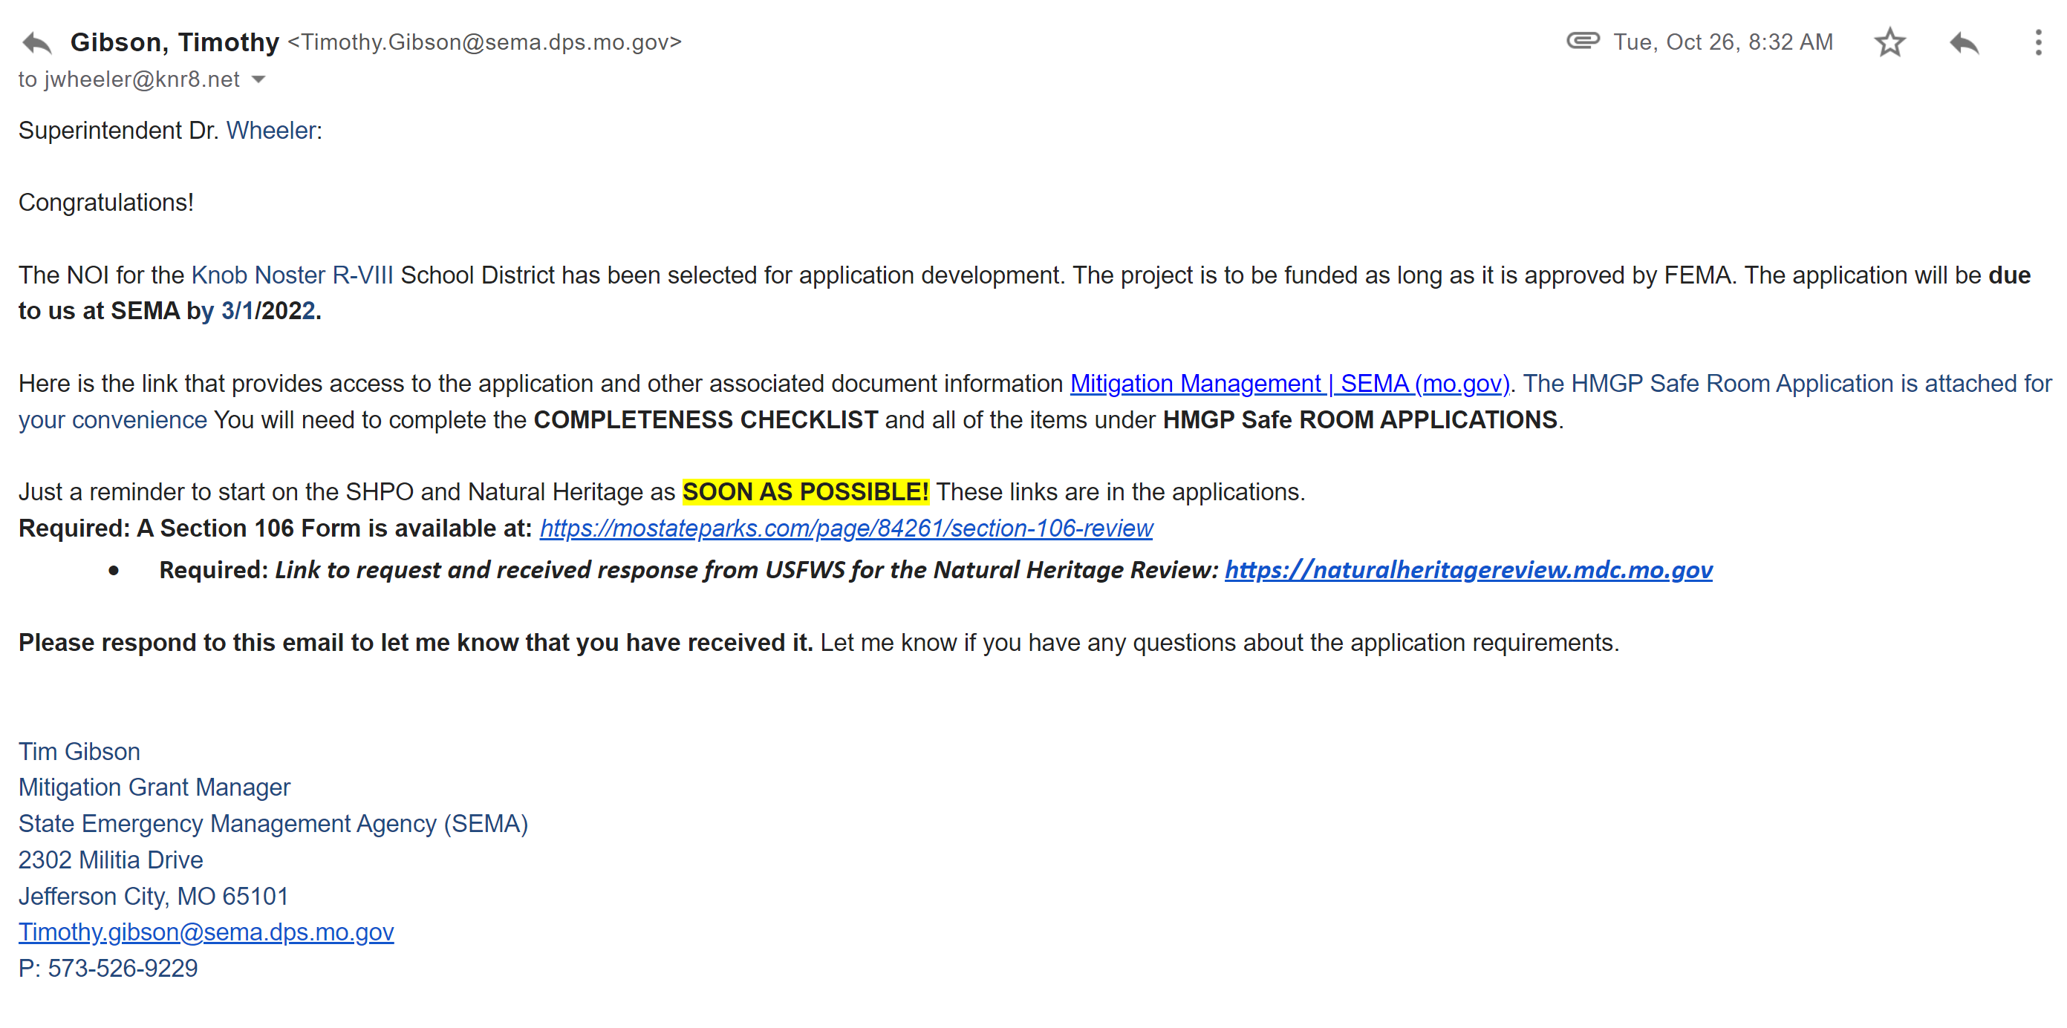
$4.5 Million SEMA Grant Notice
For the proposed $170’ +/- Diameter Monolithic Dome Saferoom / Gymnasium

Slide 31
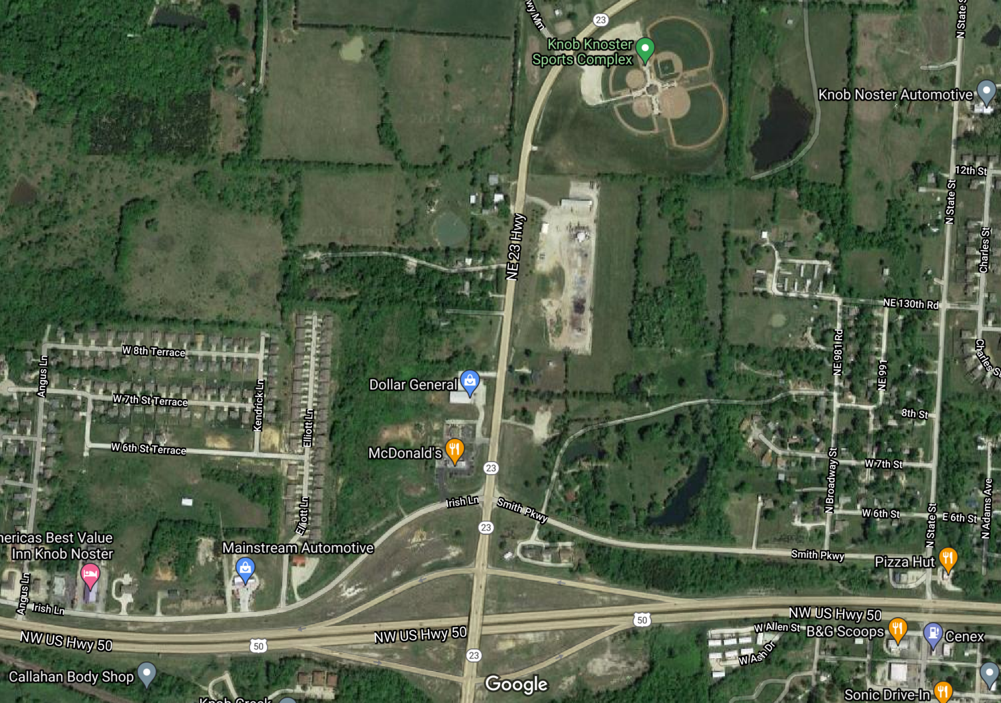
Site Orientation
Proposed Knob Noster High School Innovation Campus
The site for the proposed new facility is located just north of the intersection of Hwy 50 and Hwy 23, the main exit servicing Whiteman AFB and Knob Noster. The site is approximately 1 mile from the main entrance to Whiteman AFB
(Spirit Gate).

Slide 32
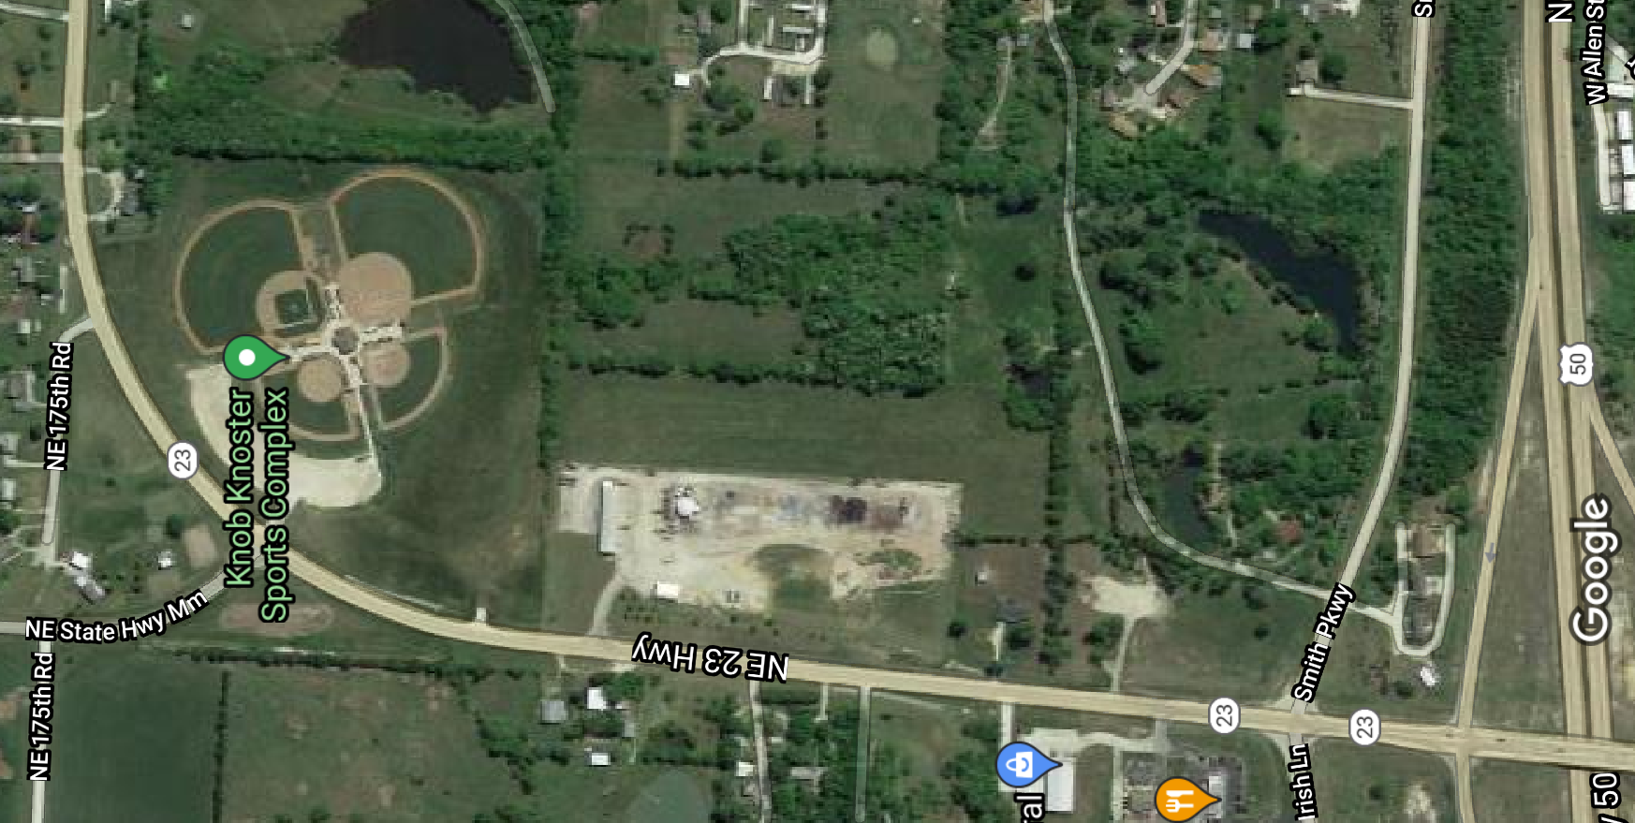
Site Orientation
Boundary Lines for the Proposed
Knob Noster High School Innovation Campus

Slide 33
References
Knob Noster Public Schools – Partnership of Excellence Highlight Video
Knob Noster Public Schools – Whiteman AFB Stealth Partnership Video
Knob Noster Public Schools – Forbes Profile Article
Knob Noster Public Schools – 2018 DoDEA Grant Announcement Video
Knob Noster Public Schools – Our Mission Is Student Success!
Joint Letter to National Governors Association
SECAF Heather Wilson on Quality of Life and Public Education
Air Force and Civic Leaders Work To build Stronger Bases
Education Week: Impact Aid is A Lifeline To Military Connected Students
Trump / DeVos Advocate for More Support for Military Students But Against Change to Impact Aid
District Administration: Federal Impact Aid Strengthens Education for Military Students

Slide 34
Building the Future Community Forum December 14, 2021

